Slide 1
Solar Power Usage vs Country’s GDP
Elza Hayyat, Sammy Mohn, Tony Garcia, Kim Trejo

Slide 2
Datasets Used
Kaggle: Solar Power by Country
https://www.kaggle.com/prasertk/solar-power-by-country
The World Bank: GDP by Country
https://data.worldbank.org/indicator/NY.GDP.PCAP.PP.CD

Slide 3
Questions
How does solar power capacity compare from 2016 through 2020?
Does a country with higher GDP have more solar power capacity than a country with lower GDP?
When looking at specific countries based on highest and lowest average GDP, what is the solar power capacity trend that is observed?

Slide 4
Cleaning Process
Renamed columns
Removed columns we don’t need
Dropped Solar_New to keep more data
Merged the two datasets according to Country
Dropped NA values
→ Navigate to Jupyter Notebook

Slide 5
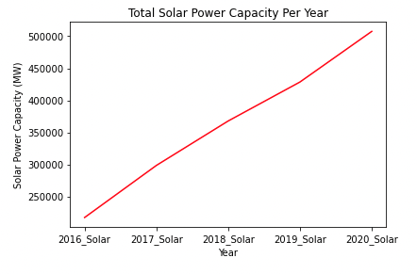
Question 1: How does solar power capacity compare from 2016 through 2020?
Consistent increase in net solar power capacity (MW) per year on average across all countries
Notes:
GDP aside, there is a very consistent increase in solar power capacity (MW) per year on average across all countries.

Slide 6
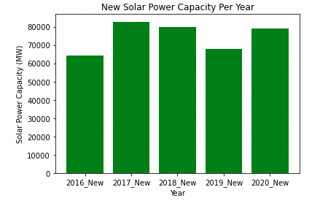
Question 1: Continuation
When looking specifically at new solar power capacity added per year, the trend differs yearly with 2017 being the highest, 2016 the lowest
Notes:
Zooming into “New” solar power capacity added every year, on average across all countries
2017 highest, 2016 lowest
Looking at 2020,

Slide 7
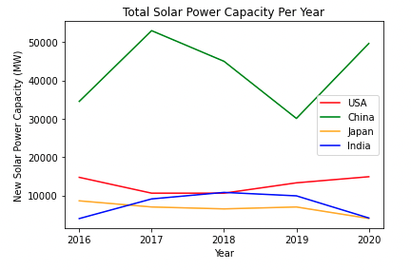
Question 1: Specific countries
Trend varies across countries
Focus here was on “top 4” countries with highest new solar power capacity added yearly

Slide 8
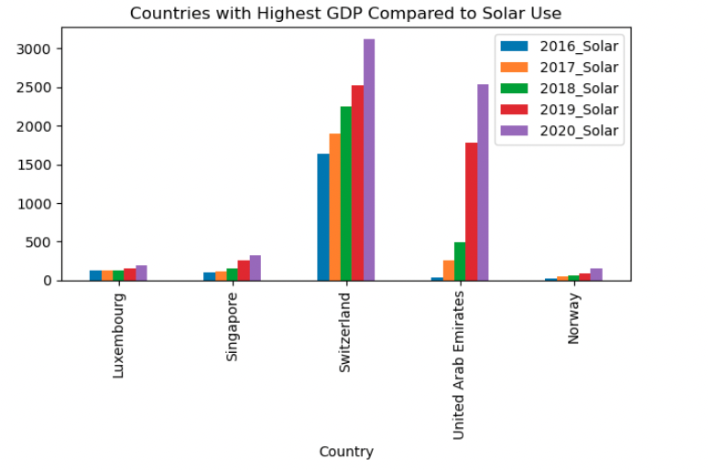
Question 2: Does a country with higher GDP have more solar power capacity than a country with lower GDP?
3 out of the 5 countries with the highest GDP average show a significantly smaller solar power capacity. One of the biggest take away was the growth from year to year for United Arab Emirates.

Slide 9
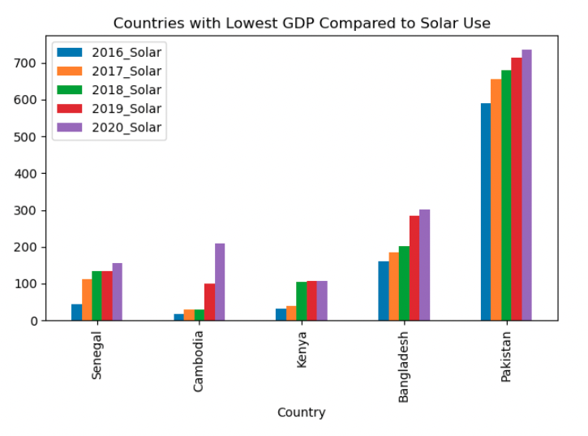
Question 2: Lowest GDP
The lowest average GDP for countries has similar results to the highest average countries. Pakistan has higher solar capacity than Luxembourg, Singapore and Norway.

Slide 10
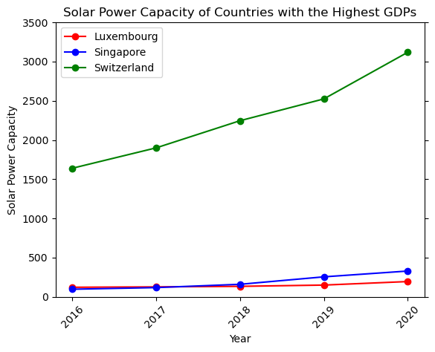
Question 3: When looking at specific countries based on highest and lowest average GDP, what is the solar power capacity trend that is observed?
Switzerland had the largest solar power capacity total & growth of the three countries with the highest average GDP during all five years

Slide 11
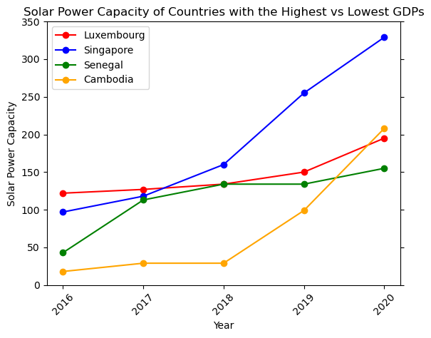
Question 3: Continuation
Comparing solar power capacity of the countries with the highest and lowest average GDPs shows that:
Similar solar power capacities from 2016-2020 across average GDP
Singapore and Cambodia had more growth than Luxembourg and Senegal, which remained consistent

Slide 12
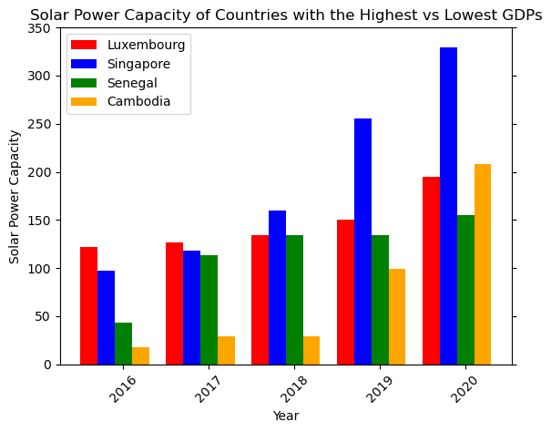
Question 3: Final
By plotting the same data from the previous slide as a bar chart, we see that:
Singapore eclipsed the other countries in solar power capacity
Solar power capacity does not always correspond with GDP
Growth in solar power capacity also doesn’t correspond with GDP

Slide 13
Challenges & Limitations
The dataset for solar power capacity had many NaN values in columns for “New Solar Power,” so we had to exclude those columns from our merged dataset. It would have been interesting to have used that data more
Both datasets were limited to the years 2016-2020. Data spanning 10 or 15 years would have shown more long-term trends in solar power capacity
If we had more time and access to more databases, we could’ve also compared other methods of power-generation

Slide 14
Other considerations:
Does climate of country affect power usage/type?
Does level of education of population affect types of power available in the country?
How does solar power usage in countries compare to other methods of power-generation?

Slide 15
Begin Q&A
Thank you all for listening!

